Slide 2



Slide 3
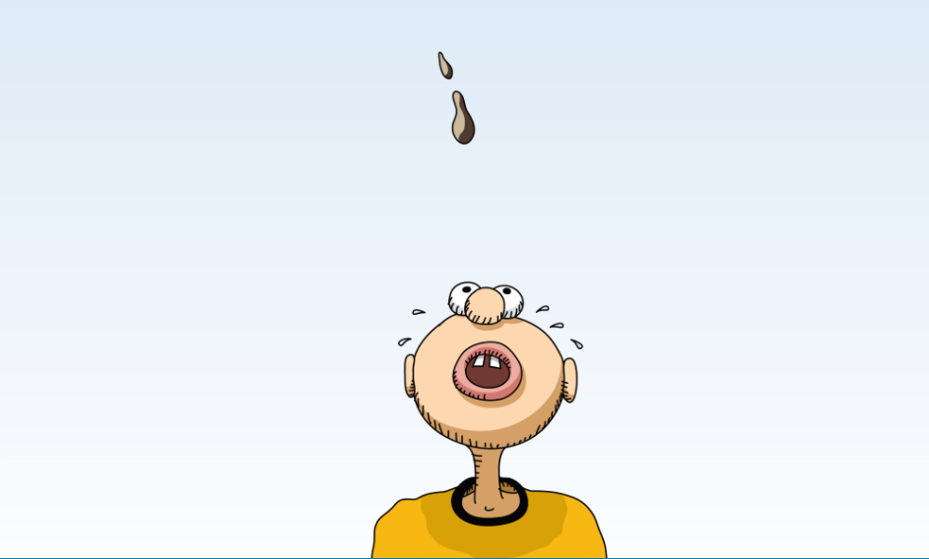

Slide 5



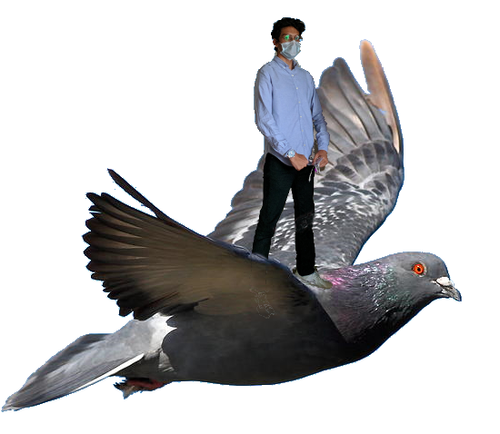

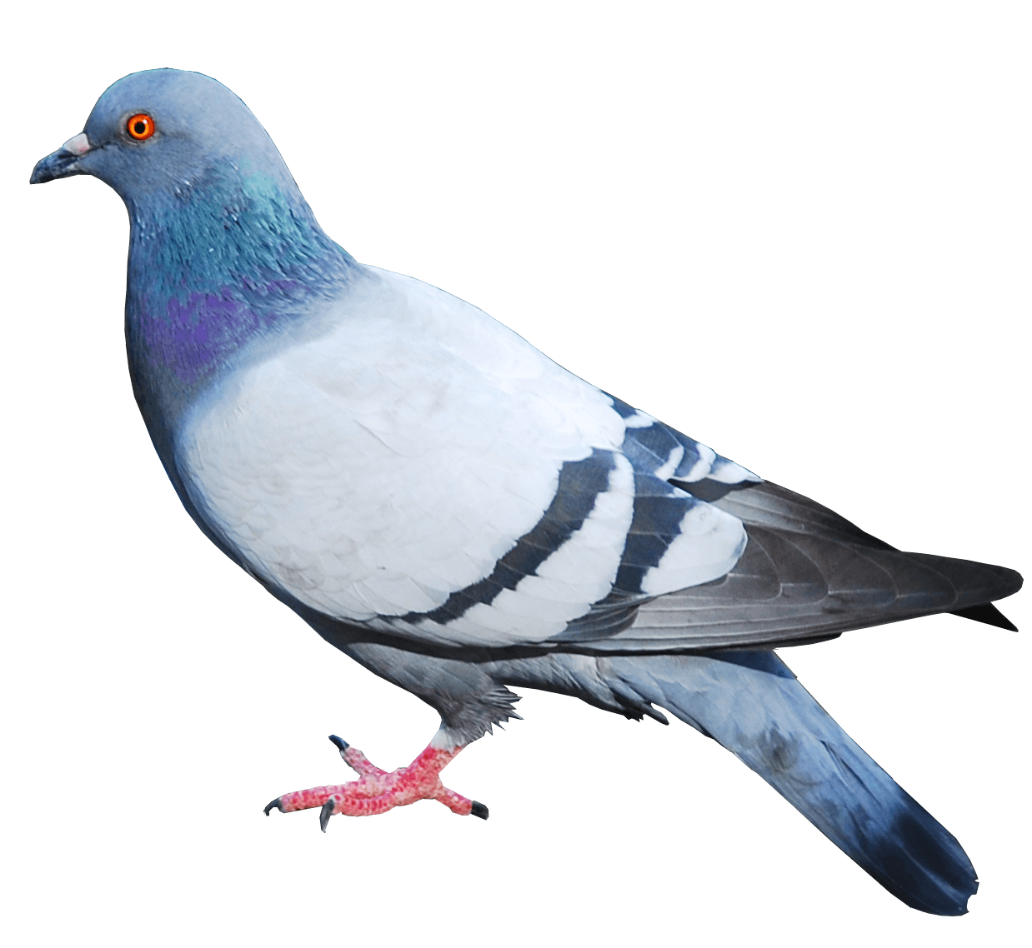
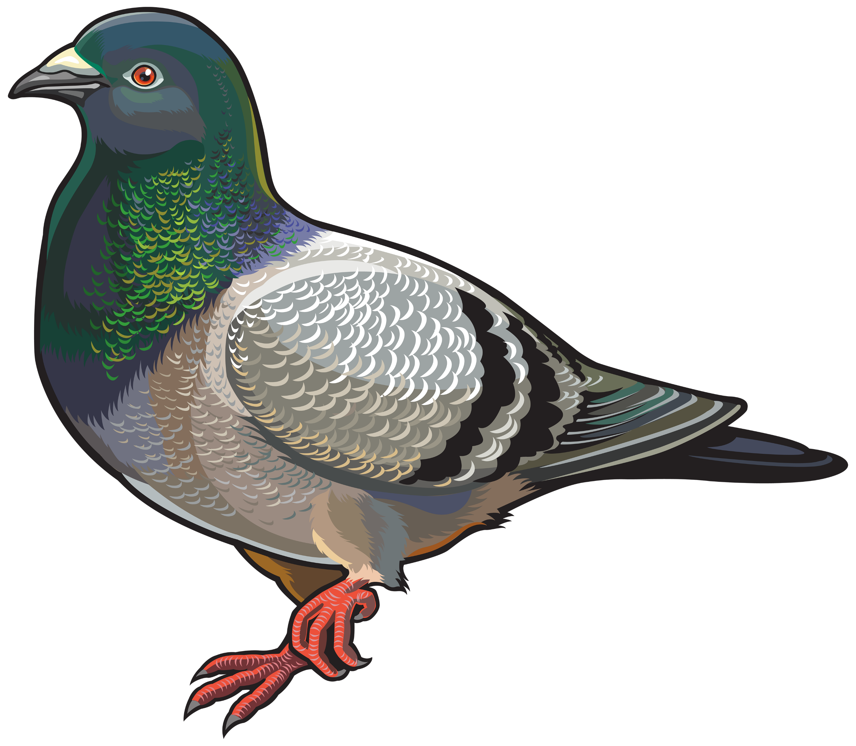

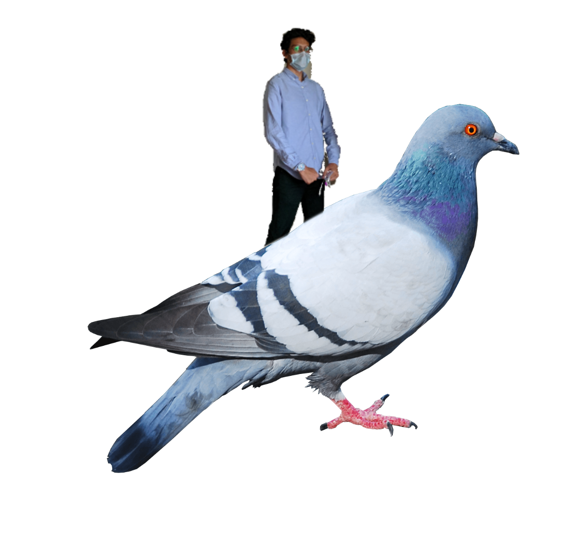



✔
HU SNaKeS & Kabootars
HU SNaKeS & Kabootars
HU Sneks & Kabootars
HU Sneks & Kabootars
HU Sneks & Kabootars
HU Sneks & Kabootars
HU Sneks & Kabootars
HU 🐍 & 🕊
HU Sneks & Kabootars
HU 🐍 & kabootars
HU Sneks & Kabootars
Notes:
Maybe Murtaza the Bird Whisperer is a man of the birds and instead of having the pigeons poop on him and drag him down; they fly him up (i.e. for this character the kabootars = ladders and ladders = ladders – or maybe we say ladders = snakes, because they bring bad luck).

Slide 6

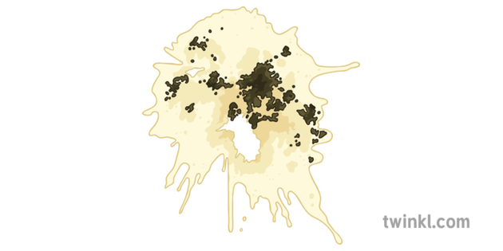
100
70
71
73
1

Slide 7
100
70
71
73
1

Slide 8
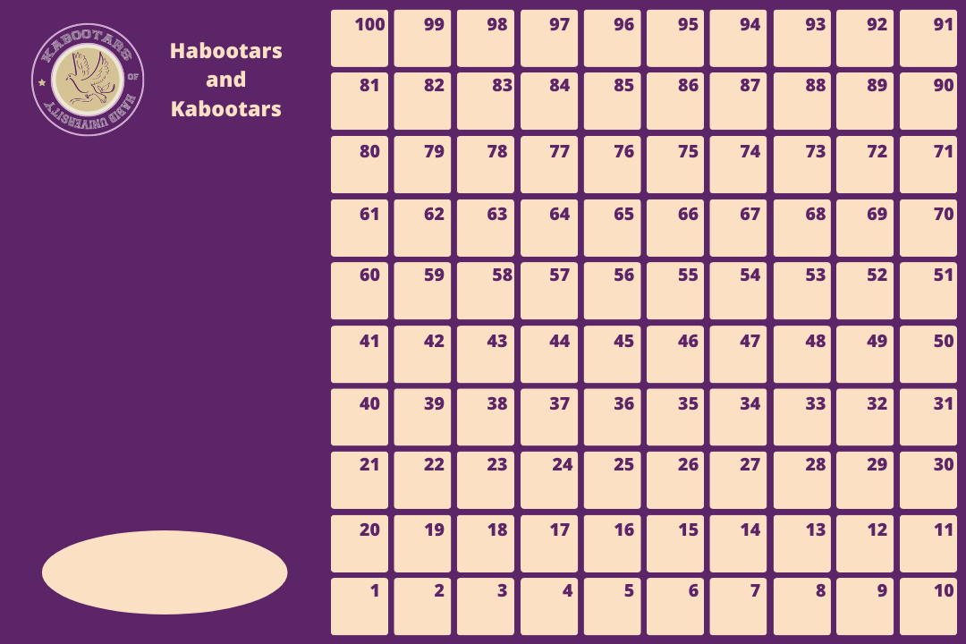

Slide 9
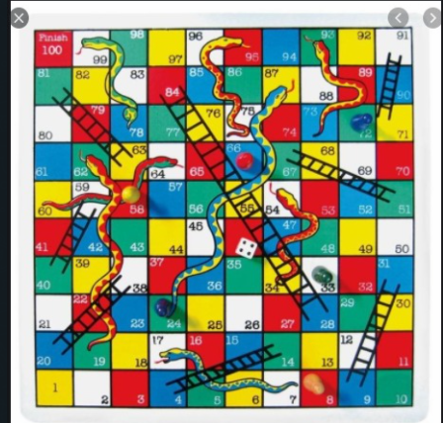

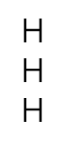


100
70
71
73
Option A | B
Poops => khabootar/habootar | Poops =>khabootar
 | habootar
Why can’t the user go forwards for the nearest restroom?
Because they’re a freshie and they dk the campus
1

Slide 10

100
70
71
73
1
2
3
Snakes vs kabootars
4
5
6
Player X won!
1
Player X’s Turn!
Player X rolled 1
Player X won!

Slide 11
100
NARRATIVE SCREEN
70
71
73
1
2
3
Snakes vs kabootars
4
5
6
Player X won!
1
Player X’s Turn!
Player X rolled 1
Player X won!

Slide 12
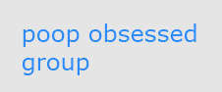
Good Kabootar, Bad Kabootar
(GKBK)
Good Kabootar; Habootar and it flies you high on world class positions / flies you over the bar
Bad kabootar; whines & poops and sends you to the rest room

Slide 13
We need:
Menu
Start button
Help button + gives some context
Cool pigeon image + other graphics?
Game-screen:
Blit Board (different sizes – potential extra feature)
Blit each box with text – consider how to blit – make sure it’s scalable, easy to use, low space-time complexity (//Overlay data on 10*10 grid)
Blit each Khabootar’s poop, habootar, and player character (upto 4 characters?)
Animated movement back to nearest piece?
Animated movement of Murtaza the birdkeeper Habootar crossing the screen when you get a ladder?
Animated kismet waala function
set of bars (probably needs better visuals)
With text and moving pointer
We might need more elements to make the gameboard visually interesting – add “scenic spots on this 10x10 campus” (from Sudais’s link) + maybe big events in HU exp. on spots too + Rahim bhai stall etc. ?
Win/Lose screen + message
Win: congratulations certificate – congratulations – you’ve gotten the next best thing to HU in COVID (Habootar edition)
Lose: loser, noob – quit whining / conduct letter / Outlook themed message – bet you couldn’t leave your whining Khabootarness behind. ☹
Retry button / go back to main menu ?

Slide 15
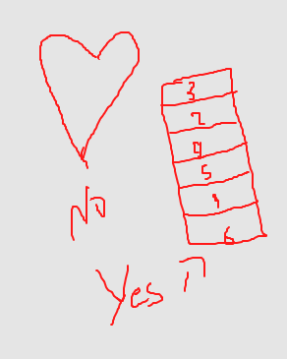
Kismat function: also has 0, ⇒ poop giri hai.
6 boxes – not really interested.
No-name-yet: equally sized rectangles/selection areas.
Spinning wheel…
Blit on the screen

